Slide 1




Improved Workflow and Expanded Functionality of RsNLME version 1.1
March 2nd, 2022
Keith Nieforth,
Senior Director, Software Product Management James Craig,
R Software Engineer and Shiny Developer
1
© Copyright 2022 Certara, L.P. All rights reserved.

Slide 2


Webinar Logistics
1-hour webinar with Q & A
All attendees are muted
Use the Questions panel to ask questions
?
Q&A
2
© Copyright 2022 Certara, L.P. All rights reserved.

Slide 3
Webinar Topics
Recap of strategy behind RsNLME
There’s an “R” in Reporting!
Demo: Using RsNLME in parallel with Rmarkdown for efficient reporting
3
© Copyright 2022 Certara, L.P. All rights reserved.

Slide 4
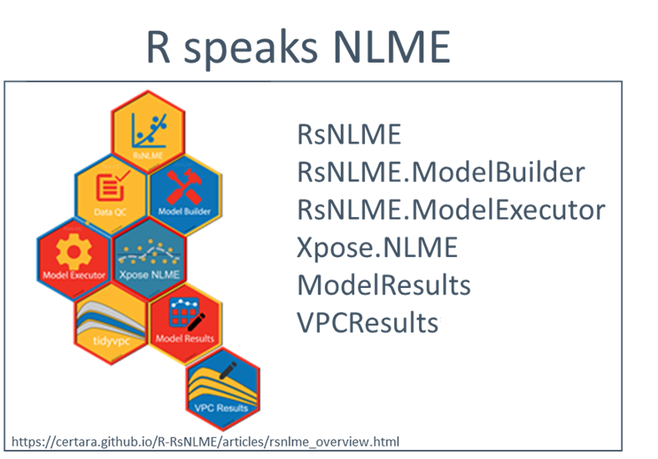
What is RsNLME?
A Certara supported environment for pharmacometric work in R
RsNLME is a collection of open source R packages
Supports pharmacometric modeling using Certara’s NLME engine, and Pharmacometrics Modeling Language (PML) directly from the R command line
Key workflow steps are supported by intuitive RShiny apps, which generate R code for you as either a final product, or a starting point for something custom
https://certara.github.io/R-RsNLME/index.html
4
© Copyright 2022 Certara, L.P. All rights reserved.

Slide 5

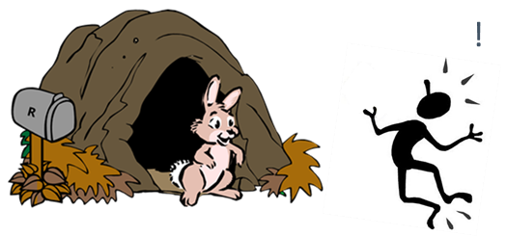
Why Did We Build RsNLME?
To extend the capability of our PMX tools, and to help users and organizations realize the benefits of R in their PMX workflows
User Perspective
R is hard. RsNLME helps to lower the learning curve
“Tools that teach”
Can gradually transition from Phoenix into R with familiar modeling syntax
RsNLME is free for students/academia
Learn early on tools that industry uses
Organizational Perspective
Full-Scope, Scalable Solutions
Combination of Phoenix, RsNLME (+\- Pirana) provides an environment that supports full spectrum of analyst skill levels and analysis complexity
A junior scientist can progress from NCA in WinNonlin to command line population modeling in R on the same systems
Fully Supported by Certara
Analysis “language” tools like R can be challenging to support
Often involves significant overhead for business
Workflow support beyond “core” PMX analysis
e.g., configurable to downstream document format requirements
5
© Copyright 2022 Certara, L.P. All rights reserved.

Slide 6
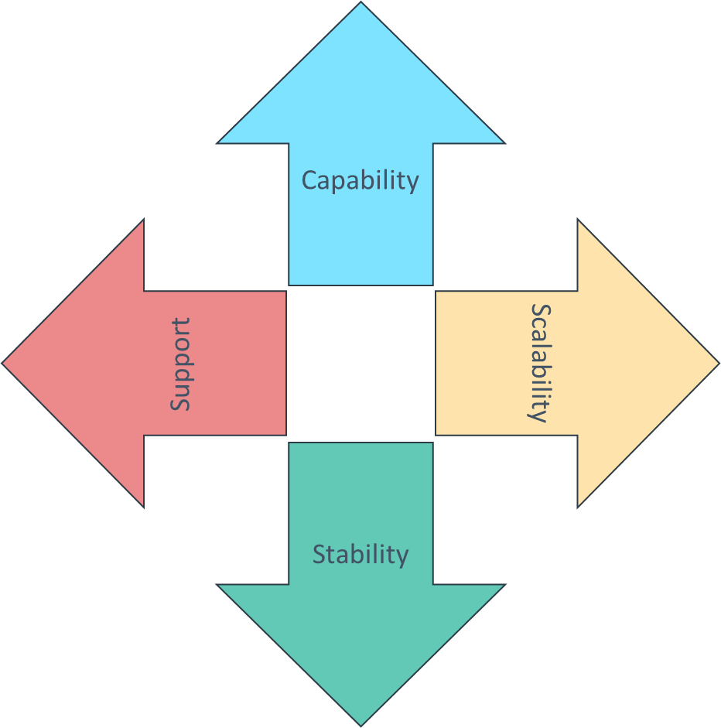

Professional Tools for Professional Development Organizations
Multidimensional Solutions
Capability
Features that support the most advanced job requirements
Scalability
Solutions that can grow with an individual and with an organization
Stability
Holistic and progressive design plan that will not leave individuals or organizations stranded
Support
Backed by a world class support organization
6
© Copyright 2022 Certara, L.P. All rights reserved.

Slide 7
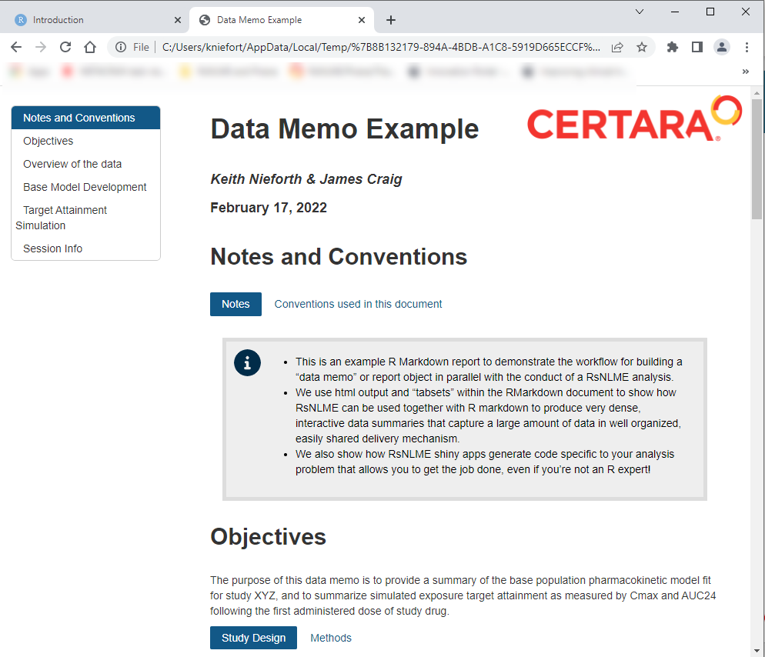
Demo
Using RsNLME with R Markdown for Reporting
What is R Markdown?
Authoring framework for data science
Allows you to combine written text and code in a single script to produce a complete document
Efficiently create reproducible, high quality documents in html, pdf or Word format
https://rmarkdown.rstudio.com/
We’ll create an example data memo in html format
Why html?
Extremely “dense” document format
Can summarize a large amount of information in a small, easily navigable space
Readily transferrable and readable by any browser (smartphone too!)
We will also show how to use RsNLME shiny applications to help with some of the code
This full demo is on github
https://github.com/certara/RsNLME-Rmd-Report-Example
7
© Copyright 2022 Certara, L.P. All rights reserved.

Slide 8
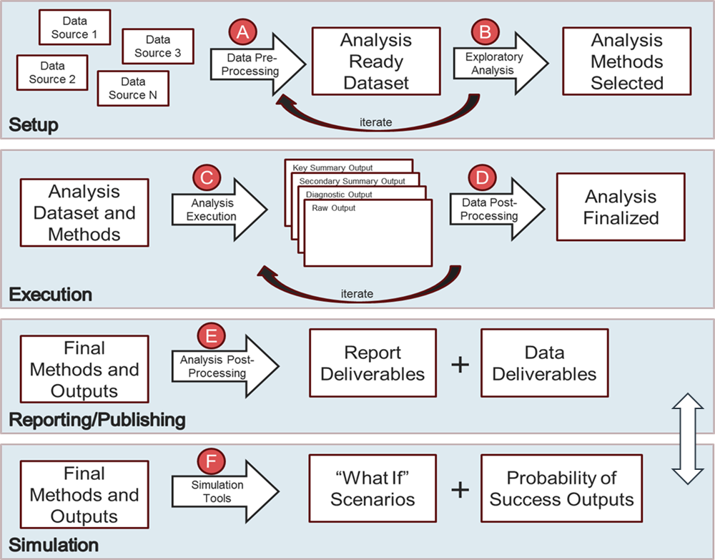
The PMX Workflow
Data Sources to Final Deliverables (reports, submissions packages)
Analysis conduct is generally a long, iterative process
Report is consolidation of outputs from different stages of analysis, sometimes separated by weeks, months
Waiting until end of analysis to start report is inefficient
Tasks that can be done in parallel are instead done in sequence
Can result in “unplanned” iteration if issues are discovered upon creation of what should be final displays
Size of “iteration loop” is larger when wait as well
8
© Copyright 2022 Certara, L.P. All rights reserved.

Slide 9
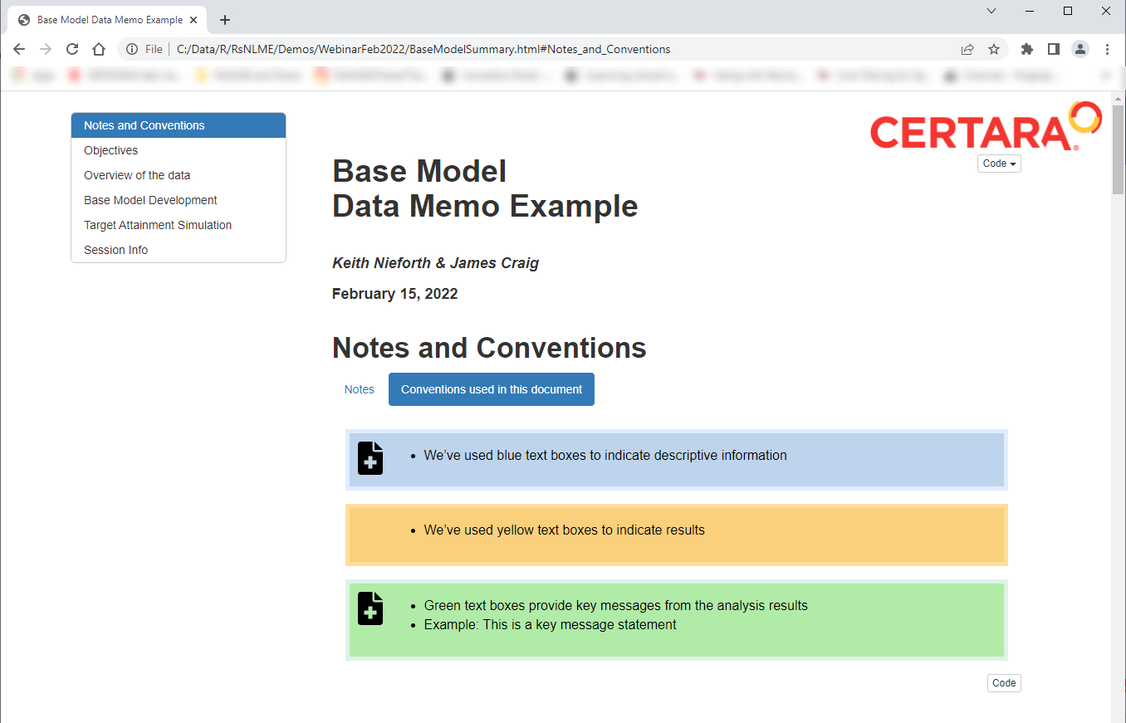
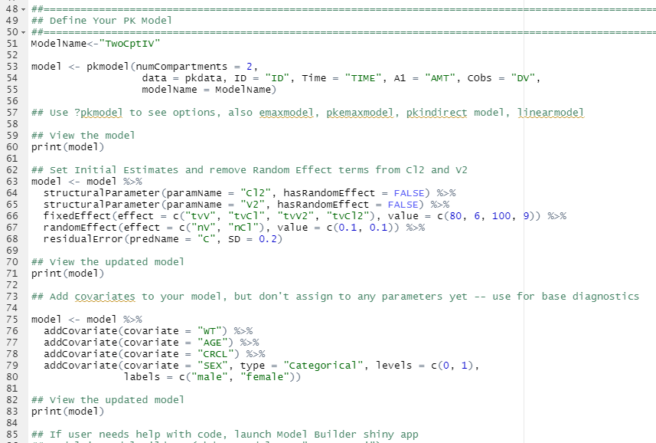
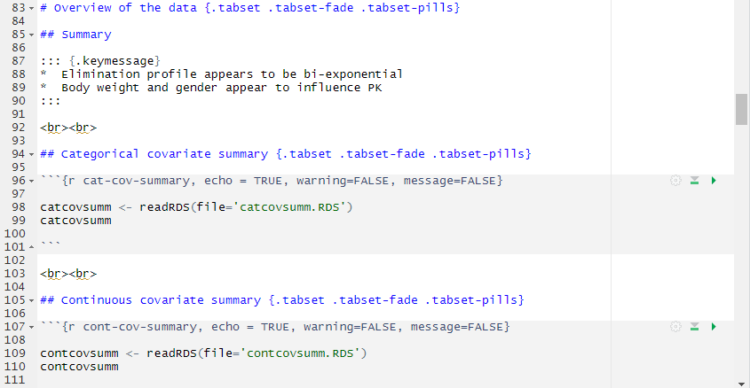
Build the Report in Parallel with Conducting the Analysis
Capture report objects at the time of creation in the analysis workflow
Creating report elements when problem is fresh in mind
Identify issues earlier than waiting until analysis completion
Very little lag time between analysis completion and report delivery
Data Memo
RsNLME Script
RMarkdown Script
Object 1
Object 2
“knit”
Object 3
Object 4
Conduct Analysis
Report Analysis
9
© Copyright 2022 Certara, L.P. All rights reserved.

Slide 10
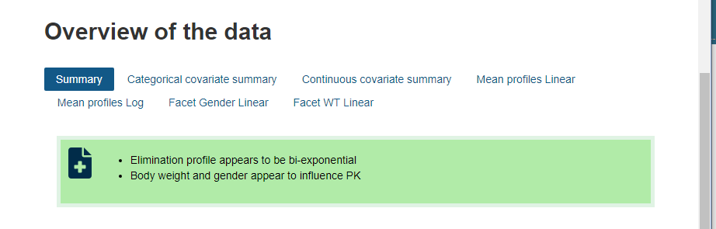
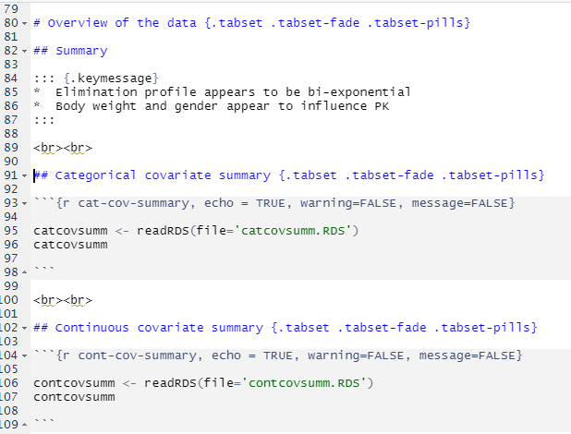
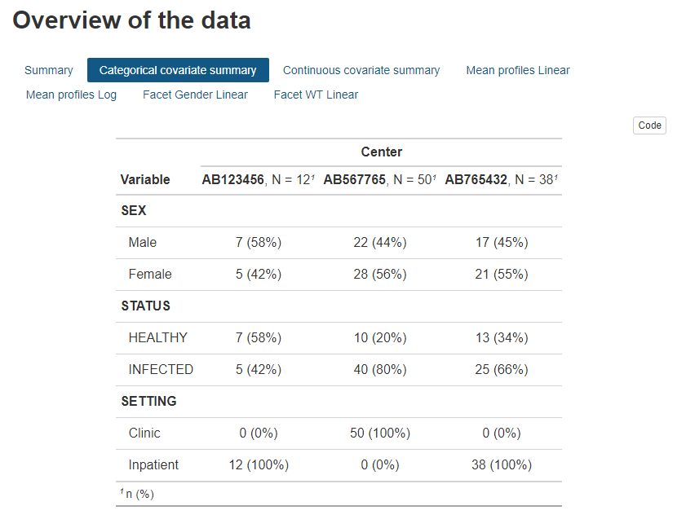
R Markdown Code Pictorial
.tabset option to use tabs
# indicates level of header
Level 2 header = tab
Apply a style to text
* Use bullets
“Backticks” enclose code “chunks”
R code
Another Level 2 header = tab
more R code

Slide 11
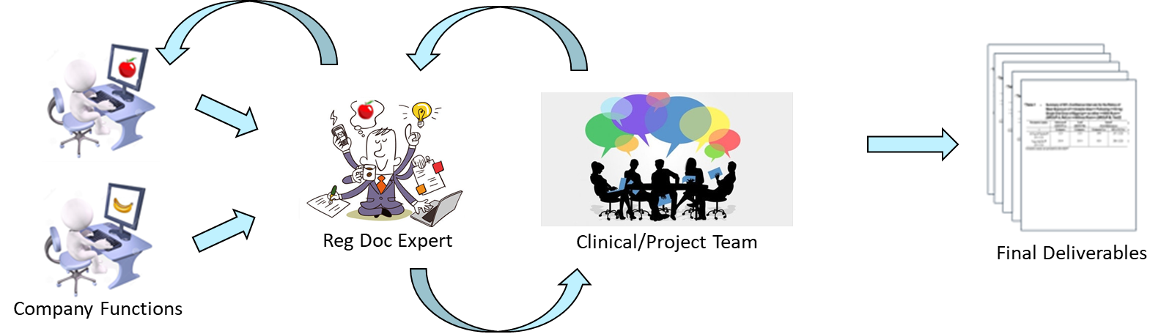





Reporting Workflow – Organizational Benefit Beyond the Analysis
“Final” Reporting Workflow
Clinical study report preparation is a team effort
Often (expertly) managed by regulatory documentation specialists with their own domain toolsets
Adherence to regulatory publishing format and content guidelines ensures quality and transferability of reports between sponsor and regulatory agencies, within agency divisions, across national regulatory boundaries, etc.
When documentation experts receive report components that do not follow template standards, it can take hours to correct formatting issues alone
RsNLME can lend harmonization to the overall reporting workflow within an organization
Allows analyst to format outputs to downstream requirements at time of creation
https://certara.github.io/R-model-results/articles/rmd_styling.html#use-ms-word-docx-style-template-1
RsNLME
PMX Analyst
11
© Copyright 2022 Certara, L.P. All rights reserved.

Slide 12
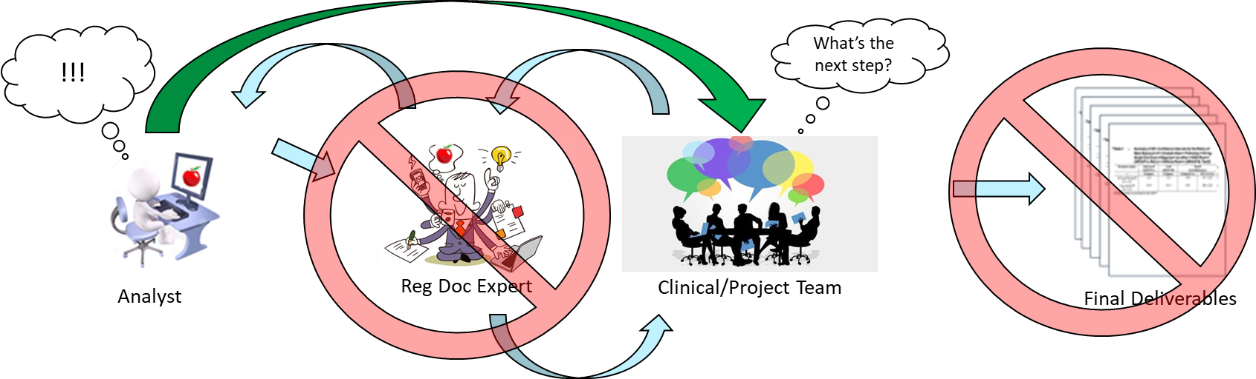
Use Case for Today’s Demonstration
“Preliminary” Analysis…
Very common use case
Analyst receives new data and needs to quickly provide preliminary results to team to inform next steps decisions
Focus on a key question, usual delivery mechanism is a “data memo” or slide deck
“Final” deliverable process too slow (e.g., competing project resources) or unable (e.g., blinding) to support
Analyst adapts to meet the needs of the team
12
© Copyright 2022 Certara, L.P. All rights reserved.

Slide 13
Demo

Slide 14
RsNLME Resources
Accessible and Interactive
This demo:
https://github.com/certara/RsNLME-Rmd-Report-Example
RsNLME Documentation:
“Packagedown” websites for all RsNLME packages. Includes example vignettes, references, basic and advanced use cases
https://certara.github.io/R-RsNLME/index.html
Certara R Solutions Documentation:
The central hub for information on Certara R tools. Certara.R is available on CRAN
https://certara.github.io/R-Certara/
Interactive RsNLME Tutorial using the R learnr package
Designed for novice R/RsNLME user
Allows “hands on” use of RsNLME without any installation/sales calls/etc.
https://pharmacometrics.shinyapps.io/rsnlmecommandlinetutorialfinal/
Certara R School Coming in April !!
Series of guided webinars, exercises, and interactive tutorials for the use of RsNLME in Pharmacometrics
We will cover everything from R installation/environment setup to creating interactive dashboards to communicate your analysis results
https://certara.github.io/R-Certara/articles/lessons.html
14
© Copyright 2022 Certara, L.P. All rights reserved.

Slide 15

?
?
?
Ideas? Suggestions? Please contact keith.nieforth@certara.com
15
© Copyright 2022 Certara, L.P. All rights reserved.

Slide 16
Accelerating Medicines, Together
Questions?
For more information on RsNLME, please visit: https://www.certara.com/software/r-speaks-nlme-rsnlme/
16
© Copyright 2022 Certara, L.P. All rights reserved.

